Slide 1
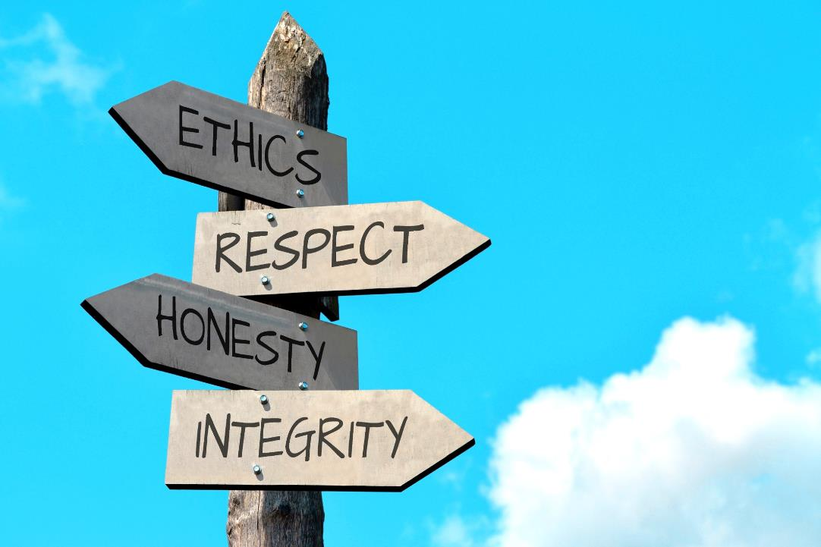
Research Ethics & Open Science
Research Methods 1

Slide 2
Research Ethics
Responsibility to be honest and respectful to all individuals who are affected by your research studies and your reports of the study’s results
Responsibility to ensure the welfare and dignity of human and non-human participants/subjects in the study
Responsibility to the discipline of science to be accurate and honest in public research reports

Slide 3
Ethics Considerations?
In an experiment, each participant interacted for an hour with another person who, unbeknownst to them, was actually an accomplice of the experimenter. After the interaction, both of them agreed to return one week later for another session with each other. When the real participants returned, they were informed that the person they had met the week before had died. The researchers then measured reactions to the death of the person.

Slide 4

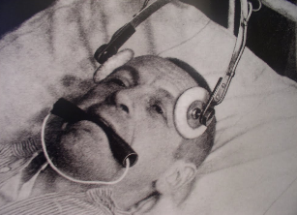
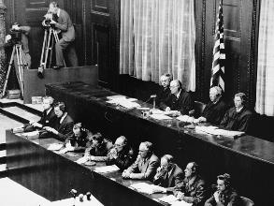

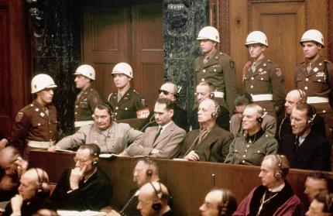
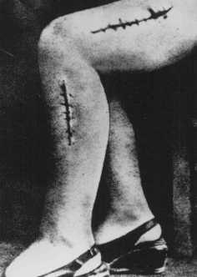
The Nuremberg Trials (1947)

Slide 5
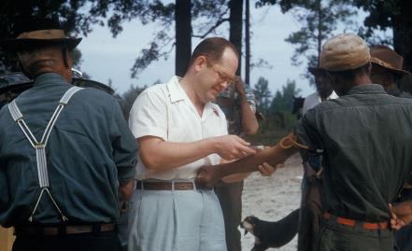
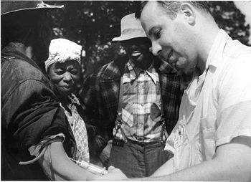
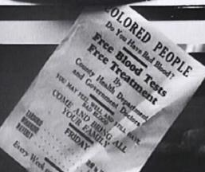
Tuskegee Syphilis Study 1932-1972
Tuskegee, Alabama

Slide 6
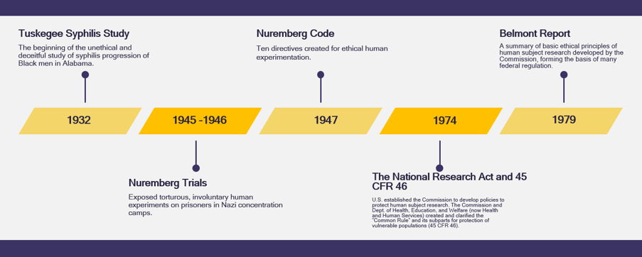

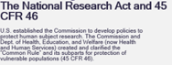
Timeline
Tuskegee Study Exposed
(1970)
Milgram Studies
(1963)
Stanford Prison Study
(1972)
Latest revision
(2010)
APA Ethics Code
(1953)

Slide 7
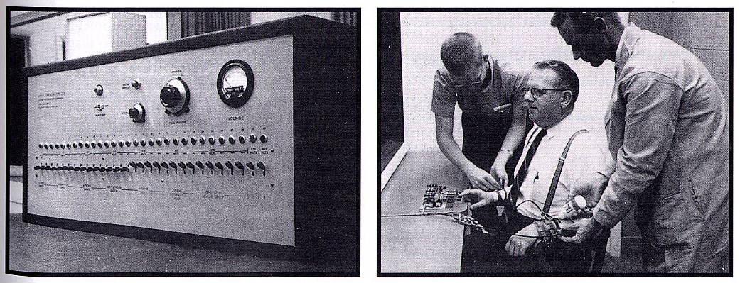
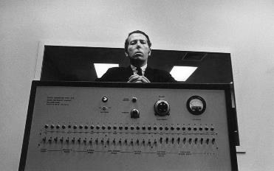
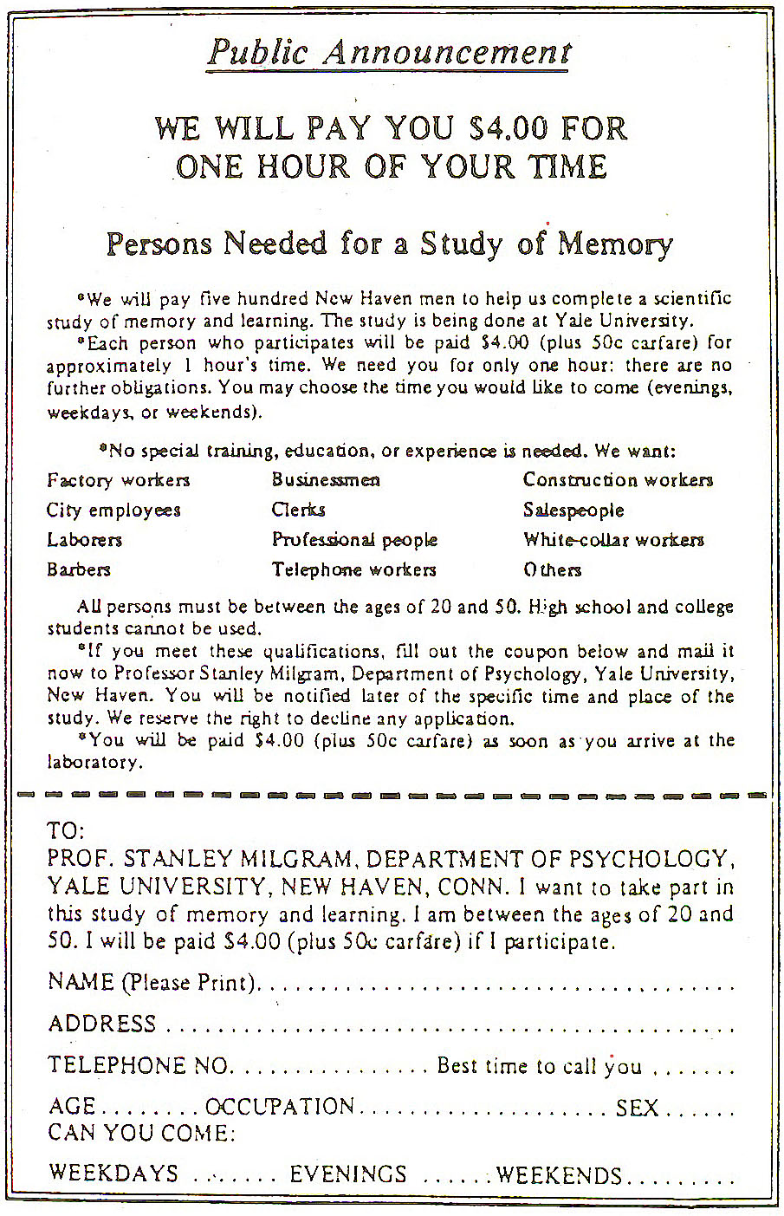
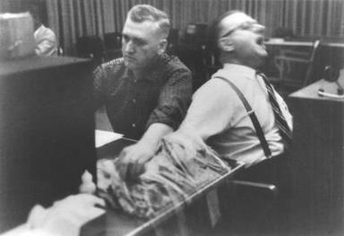
Milgram’s obedience studies (1963)

Slide 8
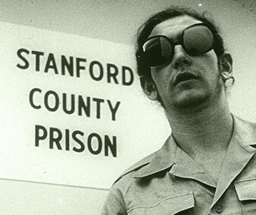
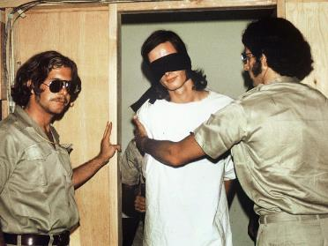
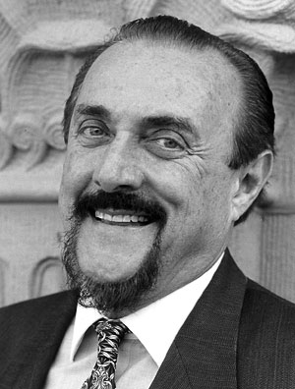
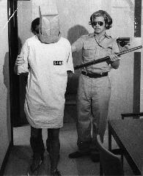
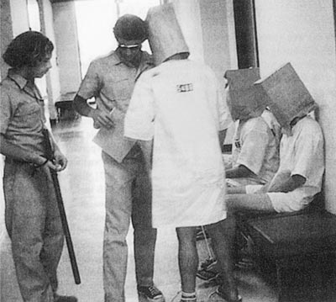
Stanford Prison Experiment (1971)
Phil Zimbardo

Slide 9
Advisory Panel Convened in 1972
National Research Act signed into law on July 12, 1974
Created the National Commission for the Protection of Human Subjects of Biomedical and Behavioral Research
Commission tasked with the development of ethical principals to guide research with human subjects
Guidelines summarized in The Belmont Report

Slide 10
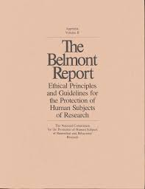
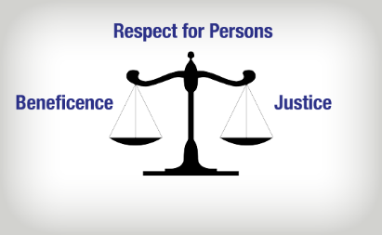
The Belmont Report (1979)
Three Basic Principles
Respect for Persons
Beneficence
Justice

Slide 11
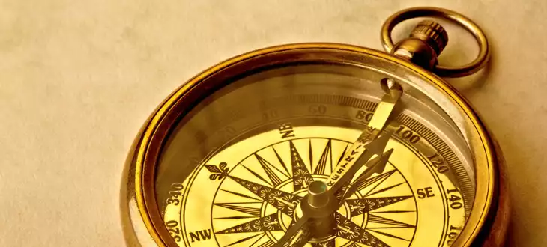
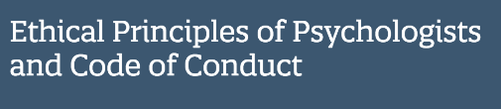
A common set of principles and standards upon which psychologists build their professional and scientific work
The Five Basic Principles
Beneficence and Non-maleficence
Fidelity and Responsibility
Integrity
Justice
Respect for People’s Rights and Dignity
http://www.apa.org/ethics/code/

Slide 12

Principle A: Beneficence and Non-maleficence
1. Do No Harm
2. Maximize Benefits and minimize risks
Physical risks: pain, death
Psychological risks: anxiety, sadness, regret, distress
Social risks: reputation, political or social reprisals
Legal risks: criminal or civil liability
Economic risks: employment loss

Slide 13
Principle B: Fidelity & Responsibility
Protecting the privacy of individuals
Keeping individuals free of unsanctioned intrusion
Do not request demographic data that would reveal identity
Protecting the confidentiality of data
Not disclosing any information relating to an individual unless the individual permits it
Properly storing and disposing of data sheets and other paper records
Limiting access to identifiable data (anonymity key)

Slide 14
Principle C: Integrity
Full disclosure of any conflicts of interests
Be honest about your research
Only use deception when there is no other method for acquiring unbiased data

Slide 15

Reputation of Science

Slide 16
Principle C: Integrity
Deception: Must be justified and reject alternatives, cannot conceal information about physical pain or psychological distress, must debrief afterwards
Passive vs. active deception
Confederates
Placebo use
Debriefing
Convey what the study was really about
Counteract/minimize any negative effects
Convey educational objective

Slide 17

Principle D: Justice
Individuals and groups must be treated equitably and equally in terms of bearing the burdens and receiving the benefits of research
Applies to recruitment of participants
Applies to use of placebos in treatment studies

Slide 18
Principle E: Respect for people’s rights & dignity
Individuals should be treated as autonomous agents (an independent person)
Persons with diminished authority are entitled to additional protections
In these cases, ethics may require seeking the consent of a legal guardian, and assent from the individual

Slide 19
Principle E: Respect for people’s rights & dignity
Informed Consent
Voluntariness Consent must be freely given or truly voluntary
Comprehension Individuals must have the mental capacity to understand the information presented to them
Disclosure Researchers must disclose all aspects of the stud

Slide 20
Documentation of Informed Consent
Form must contain:
Overview and Purpose of the Study
Description of Procedures
Potential Risks and Benefits
Costs for Participation (usually none)
Compensation
Confidentiality (including limitations)
Alternatives to Participating
Voluntary Participation
Contact Info for Principal Investigator
Form must be signed by the participant (or legal representative)

Slide 21

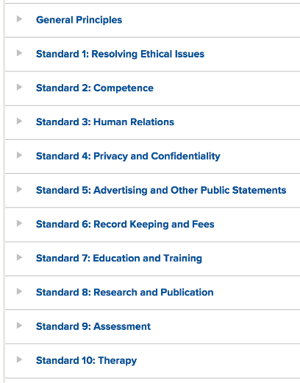
8.01 Institutional Approval
8.02 Informed Consent to Research
8.03 Informed Consent for Recording Voices and Images in Research
8.04 Client/Patient, Student, and Subordinate Research Participants
8.05 Dispensing with Informed Consent for Research
8.06 Offering Inducements for Research Participation
8.07 Deception in Research
8.08 Debriefing
8.09 Humane Care and Use of Animals in Research
8.10 Reporting Research Results
8.11 Plagiarism
8.12 Publication Credit
8.13 Duplicate Publication of Data
8.14 Sharing Research Data for Verification
8.15 Reviewers

Slide 22
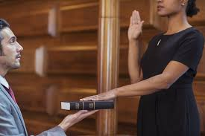
So who keeps us honest?

Slide 23
Institutional Review Board (IRB)
Headed by scientists/nonscientists in any institution/agency conducting research with human participants
Minimization of risks to participants
Reasonable risk in relation to benefits
Equitable selection
Informed consent
Documentation of informed consent
Data monitoring
Privacy and confidentiality

Slide 24
Assignment #3: Ethics Training
Any person engaging in human subjects research at Purchase College is required to submit an IRB protocol
You must include your ethics training completion certificate or number on your IRB submission
Complete the CITI training modules and submit your certificates as HW3

Slide 25
Federal Oversight
Federal Government sponsors research
Can penalize or withdraw funding from institutions that show ethical violations

Slide 26
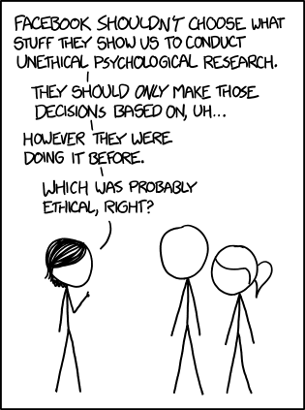
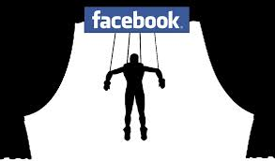
Rules Apply to those receiving government funding, not Corporations

Slide 27






Slide 28
Integrity & Open Science (Principle C)

Slide 29
Principle C: Integrity
Scientific Integrity
Avoid Fraud
You must make your raw data available for review
Any dropped cases must be noted in your publication
Fraud includes the withholding of results that do not support your hypothesis
Avoid Plagiarism
Acknowledge other people’s work
Paraphrasing requires citation

Slide 30

The Replication Crisis AKA The Credibility Revolution

Slide 31

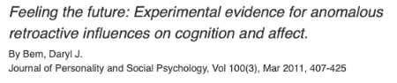
In 2011, social psychologist Daryl Bem published an article in a top journals that purported to provide evidence of psychic abilities (psi) in everyday college undergraduate participants
Many psychologists and statisticians criticized the methods and analyses in the article
This finding has since failed to replicate multiple times

Slide 32
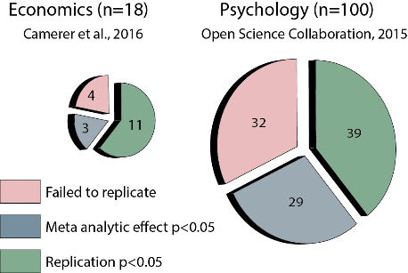
Many-Labs Replication Projects
Only 25-75% of findings reliably replicate with larger sample sizes and more variable participant samples

Slide 33
Famous Psychology Findings That Have Failed To Replicate
Power Posing increases testosterone and lowers cortisol
Self control is a limited resource (ego-depletion)
Priming people with professor stereotypes makes them score higher on intelligence tests
Priming people with words related to being old makes people walk slower (like an old person)
Priming people with images of money makes them behave more selfishly
MANY MORE!

Slide 34
Why all these false positives?
Fraud
Random chance (Type 1 errors), which is more likely with small sample sizes
The “file drawer” problem: Scientific journals want to publish “statistically significant” results, so any null findings are kept in the file drawer
Questionable Research Practices (QRPs), usually a result of poor scientific and statistical training (unlike you!)
p-hacking: digging into your data in different ways until you find p < 0.05

Slide 35
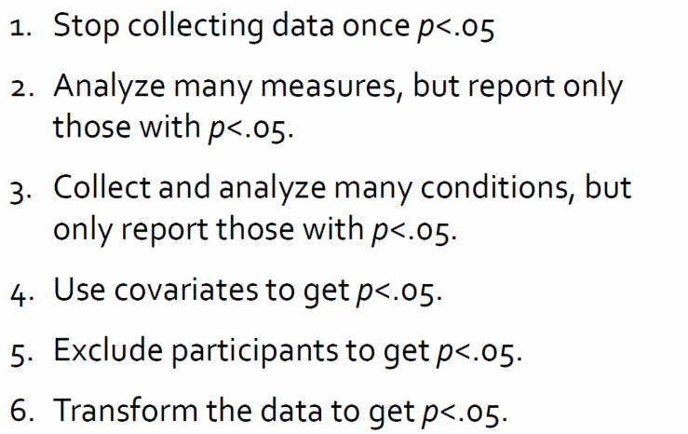
How to p-hack

Slide 36
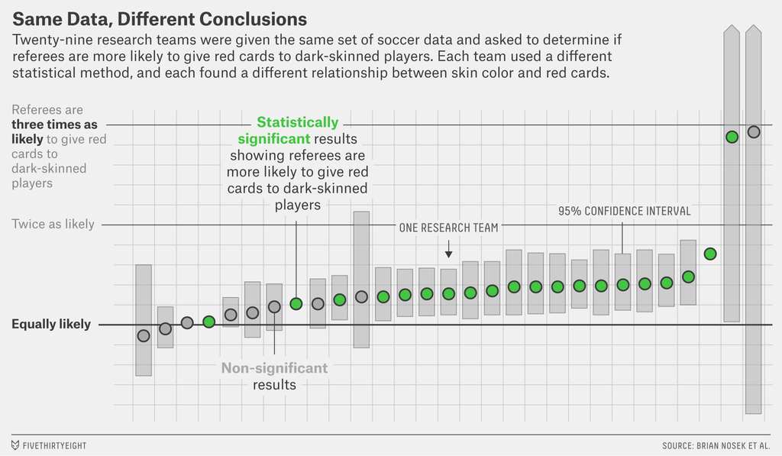

Slide 37

A solution? Open and transparent research Practices at all Stages!
Adapted from What is Open Science and why should I care? Dr. Nancy Pontika Open Access Aggregation Officer CORE Twitter: @nancypontika

Slide 38
What is Open Science?
The movement to make scientific research, data and dissemination accessible to all levels of an inquiring society [FOSTER, Open Science Definition]
Scope:
Transparency in experimental methodology, observation, collection of data, and data analysis
Public availability and reusability of scientific data
Public accessibility and transparency of scientific communication
Using web-based tools to facilitate scientific collaboration

Slide 39
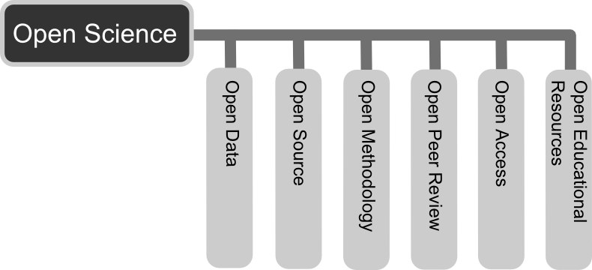
It is more than Open Access Publishing

Slide 40
Open Access To Publications
Free, immediate, online access to the results of research
Free to reuse, e.g., to build tools to mine the content
Two routes to make sure anyone can access your papers:
Gold route: paying APCs to ensure publishers make copy open
Green route: self-archiving Open Access copy in repository

Slide 41
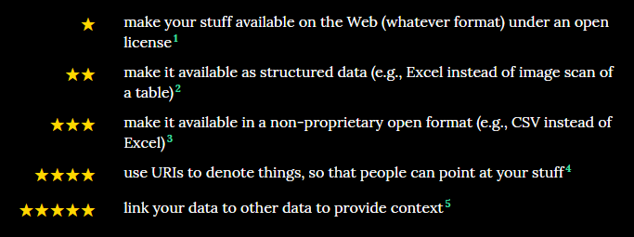
Open Data
“Open data and content can be freely used, modified, and shared by anyone for any purpose”
Tim Berners-Lee’s proposal for five star open data:

Slide 42
Open Methods
Documenting and sharing workflows and methods
Sharing code and tools to allow others to reproduce work
Using web-based tools to facilitate collaboration and interaction from the outside world
Open netbook science: “when there is a URL to a laboratory notebook that is freely available and indexed on common search engines”

Slide 43
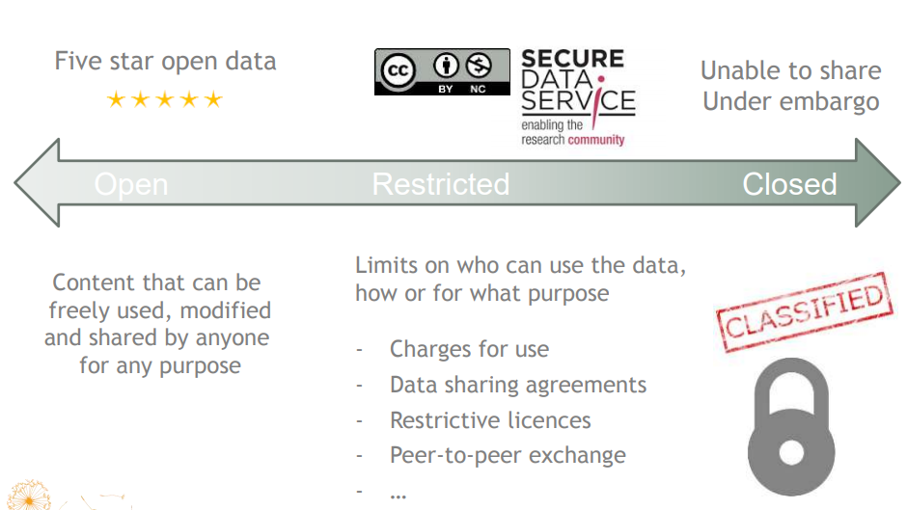
Degrees of Openness

Slide 44

Why Practice ?
Benefits and Drivers

Slide 45
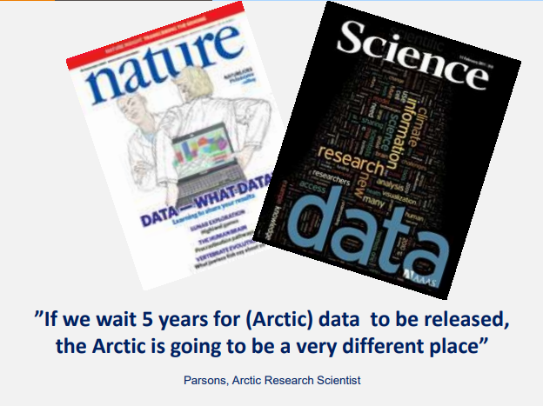

Slide 46
Some Benefits of Openness
You can access relevant literature – not behind pay walls
Ensures research is transparent and reproducible
Increased visibility, usage, and impact of your work
New collaborations and research partnerships
Ensure long-term access to your output
Help increase the efficiency of research

Slide 47
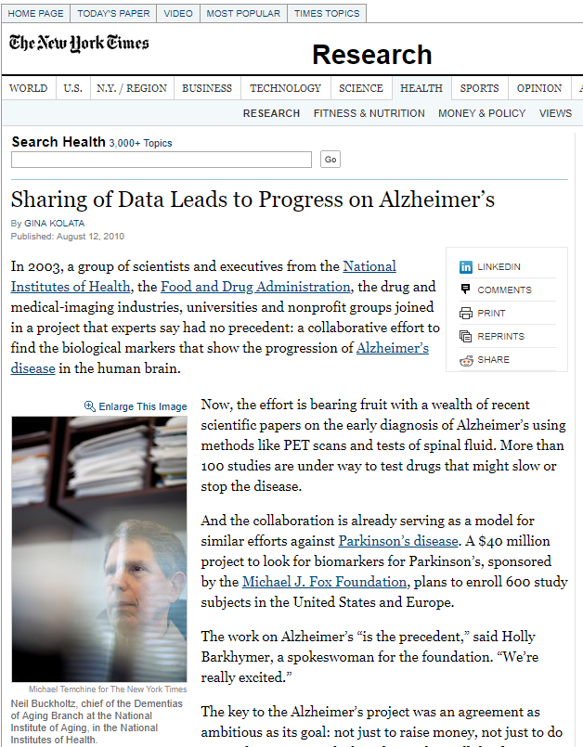
More Scientific Breakthroughs
“It was unbelievable. Its not science the way most of us have practiced in our careers. But we all realised that we would never get biomarkers unless all of us parked our egos and intellectual property noses outside the door and agreed that all of our data would be public immediately.” – Dr John Trojanowski, University of Pennsylvania

Slide 48
How Do We “Do” Open Science?
Making your publications and data open

Slide 49
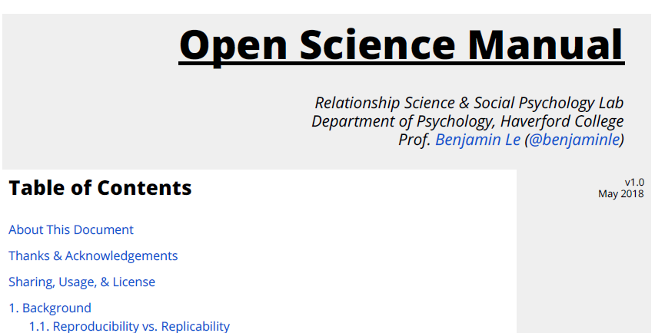
Open Science Framework (OSF)
It is free!
It is easy to use
It is IMPORTANT

Slide 50
Pre-Registration
Committing yourself to a study design, sample size, and analysis plan BEFORE you run your study
Plan for openness at the outset of a research project

